Slide 1
Sales Process Training

Slide 2
How to use SAP and the CRM for Outlook
The purpose of this training is to explain, step by step, the sales opportunities process and how to use SAP and the CRM for Outlook add-on to enter opportunities in preparation to generate proposal documents.
Notes:
Notes to presenter:
What is your purpose for sharing this reflection?
Is it at the end of a unit or project?
Are you sharing this reflection, at the attainment of a learning goal you set for yourself?
Is it at the end of a course?
State your purpose for the reflection or even the purpose of the learning experience or learning goal. Be clear and be specific in stating your purpose.

Slide 3
What will you learn?
Proper use of the SAP and CRM for Outlook software
How to correctly research Business Partner data
How to correctly enter a Business Partner
How to correctly enter Contact info
How to correctly enter Competitive Equipment
How to correctly enter a Sales Opportunity
Notes:
Notes to presenter:
Description of what you learned in your own words on one side.
Include information about the topic
Details about the topic will also be helpful here.
Tell the story of your learning experience. Just like a story there should always be a beginning, middle and an end.
On the other side, you can add a graphic that provides evidence of what you learned.
Feel free to use more than one slide to reflect upon your process. It also helps to add some video of your process.

Slide 4
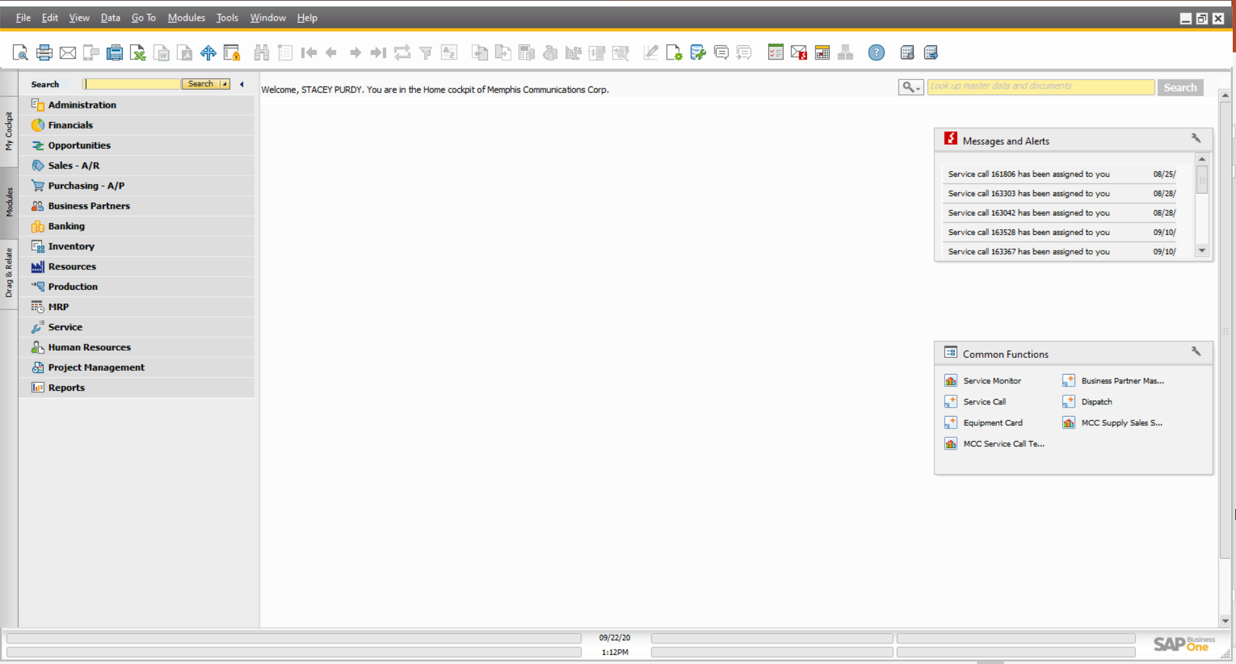
What is the difference between SAP and the CRM for Outlook add-on?
SAP Business 1 is the internal software that MCC uses to store all customer, equipment, invoice, sales, and service data. All information relevant to a client and the sales engagement should be entered into SAP either through the SAP client or the CRM for Outlook add-on.
Notes:
Notes to presenter:
Description of what you learned in your own words on one side.
Include information about the topic
Details about the topic will also be helpful here.
Tell the story of your learning experience. Just like a story there should always be a beginning, middle and an end.
On the other side, you can add a graphic that provides evidence of what you learned.
Feel free to use more than one slide to reflect upon your process. It also helps to add some video of your process.

Slide 5
What is the difference between SAP and the CRM for Outlook add-on?
The CRM for Outlook add-on is a quick way for sales reps to perform necessary duties without having to open the full SAP client. Sales reps can enter, modify, or lookup client information directly from their Outlook client and the information is added to the SAP database.
Notes:
Notes to presenter:
Description of what you learned in your own words on one side.
Include information about the topic
Details about the topic will also be helpful here.
Tell the story of your learning experience. Just like a story there should always be a beginning, middle and an end.
On the other side, you can add a graphic that provides evidence of what you learned.
Feel free to use more than one slide to reflect upon your process. It also helps to add some video of your process.

Slide 6
How to Use the CRM for Outlook
When the CRM for Outlook is enabled, there are 2 SAP tabs in the top Outlook ribbon.
The first tab is the SAP client tab and it will automatically pull up SAP client information relevant to the email currently open in Outlook. If you switch emails, the information displayed on this tab will change relevant to the new email.
If the domain name (ex., mccsolutions.net) of you email contact does not exist in SAP, you will see 2 buttons instead of the client information. To associate this contact with an existing Business Partner, click the “This is a B1 connection” button.
Clicking the “This is not a B1 connection” button will tell the CRM to ignore emails from this contact and not try to pull information. This is useful for vendors or newsletters, but is not necessary to ever use.
Notes:
Notes to presenter:
Description of what you learned in your own words on one side.
Include information about the topic
Details about the topic will also be helpful here.
Tell the story of your learning experience. Just like a story there should always be a beginning, middle and an end.
On the other side, you can add a graphic that provides evidence of what you learned.
Feel free to use more than one slide to reflect upon your process. It also helps to add some video of your process.

Slide 7
How to Use the CRM for Outlook
From the first tab, the client tab, all information on this tab will deal only with the client. All Activities, Opportunities, Quotes, Orders, etc., will be only about this specific client and creating new items will auto populate the client’s information.
On this tab, you will also find the Find and Favorites buttons. The Find button is where you will go to locate or create new Business Partners. The Favorites button allows you pull a recent history of Business Partners you have accessed and any favorites you create will remain in this list for easy access. Adding current prospects or sales leads to your favorites allows you to quickly locate the BP information throughout your sales process and keep all the necessary information handy until you close the sale.
Notes:
Notes to presenter:
Description of what you learned in your own words on one side.
Include information about the topic
Details about the topic will also be helpful here.
Tell the story of your learning experience. Just like a story there should always be a beginning, middle and an end.
On the other side, you can add a graphic that provides evidence of what you learned.
Feel free to use more than one slide to reflect upon your process. It also helps to add some video of your process.

Slide 8
How to Use the CRM for Outlook
The second tab in the CRM is all about the sales rep. On this tab you will find any Activities, Opportunities, Orders, etc., that have you listed as the Sales Rep.
Any new items created from this tab will be blank and will not auto populate with client information.
This tab is useful during the beginning of a sales process when you may not have emails from a client or need to create new items that are not associated with existing emails.
This tab also provides sales reps with all the information they need to stay organized and be aware of the status of ongoing sales opportunities and activities, in addition to their personal KPIs.
Notes:
Notes to presenter:
Description of what you learned in your own words on one side.
Include information about the topic
Details about the topic will also be helpful here.
Tell the story of your learning experience. Just like a story there should always be a beginning, middle and an end.
On the other side, you can add a graphic that provides evidence of what you learned.
Feel free to use more than one slide to reflect upon your process. It also helps to add some video of your process.

Slide 9
The Sales Process
Step by Step

Slide 10
Prospecting
Opportunity
Quotation
Each day of a Sales Representative’s day should be filled with either direct or virtual contact with prospects or existing clients.
Every opportunity to sell must be tracked as a Sales Opportunity in SAP.
Opportunities keep all relevant information regarding a specific sale in one location.
Sales Quotations are used to configure the system you are selling, and create a proposal with little to no work needing to be done outside SAP.
Notes:
Notes to presenter:
What was important about this learning experience?
How is it relevant to your course, yourself, or your society or community?
Why is this significant?
This SmartArt allows you add images and text to help outline your process. If a picture is worth a thousand words, then pictures and words should help you communicate this reflection on learning perfectly! You can always click on Insert>SmartArt to change this graphic or select the graphic and click on the Design contextual menu to change the colors.

Slide 11
Prospecting

Slide 12
Prospecting Process- Initial Step
Each day of a Sales Representative’s day should be filled with either direct or virtual contact with prospects or existing clients.
Prospects – Sales Representatives should conduct active prospecting by canvassing businesses in their designated areas, either by direct or virtual communications.
Existing Clients – Sales Representatives should make direct efforts to form or strengthen relationships with existing clients at every opportunity.
Notes:
Notes to presenter:
Description of what you learned in your own words on one side.
Include information about the topic
Details about the topic will also be helpful here.
Tell the story of your learning experience. Just like a story there should always be a beginning, middle and an end.
On the other side, you can add a graphic that provides evidence of what you learned.
Feel free to use more than one slide to reflect upon your process. It also helps to add some video of your process.

Slide 13
Prospecting Process- Initial Step (cont.)
The intent of prospecting is to gather information for potential sales today as well as to tee up potential sales for tomorrow through the gathering of contacts and competitive equipment information.
Information for new sales opportunities may come in through different channels and must all be entered in the CRM for Outlook so data can be tracked in order to provide better sales data to help improve your sales.
Notes:
Notes to presenter:
Description of what you learned in your own words on one side.
Include information about the topic
Details about the topic will also be helpful here.
Tell the story of your learning experience. Just like a story there should always be a beginning, middle and an end.
On the other side, you can add a graphic that provides evidence of what you learned.
Feel free to use more than one slide to reflect upon your process. It also helps to add some video of your process.

Slide 14
Prospecting Process- Initial Step (cont)
Once a Sales Representative obtains information, they are to use the CRM for Outlook to capture all pertinent information.
It is optimal to enter information as quickly as possible after learning about the sales opportunity.
Leveraging business cards and websites will ensure we have accurate information about the contacts and business logistics entered into the system.
Notes:
Notes to presenter:
Description of what you learned in your own words on one side.
Include information about the topic
Details about the topic will also be helpful here.
Tell the story of your learning experience. Just like a story there should always be a beginning, middle and an end.
On the other side, you can add a graphic that provides evidence of what you learned.
Feel free to use more than one slide to reflect upon your process. It also helps to add some video of your process.

Slide 15
Adding Prospects

Slide 16
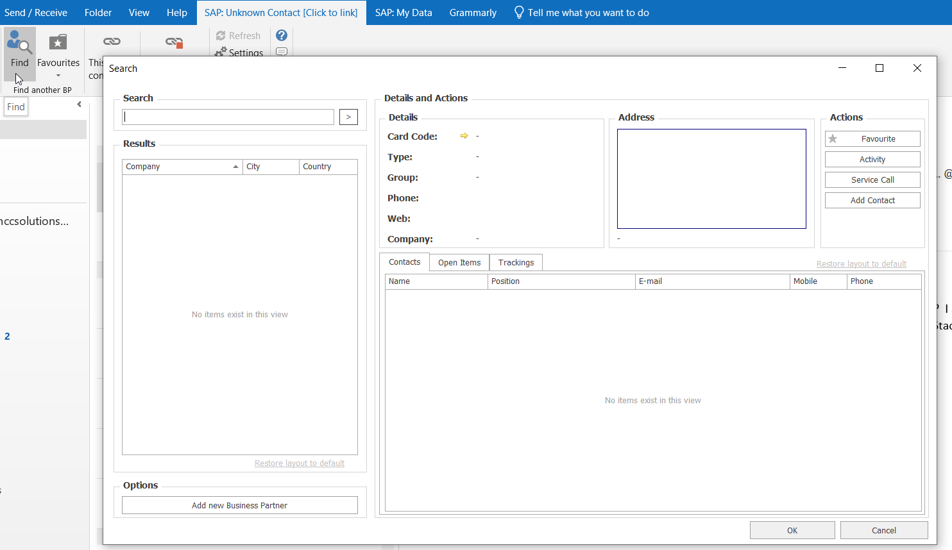
Research - Entering Prospect Information
Before entering any information into the CRM for Outlook or SAP, you MUST verify the information does not already exist.
Step 1 – Checking for an existing record before adding a new Business Partner
Open Outlook and click on the first SAP tab in the top ribbon
NOTE: If you have an existing email from the prospect, the SAP tab should pull any Business Partner information for this contact if the data already exists in SAP.
Click the Find button
In the search bar, perform the following searches to ensure you have exhausted all options:
Business name – Make sure to try all forms and spellings as well as different spacing options
Phone number
Contact name
Address
If the business already exists in our database, select that Business Partner from the list and enter the new contact information and proceed to the Add a Sales Opportunity process.
If the business is not found in our system, proceed to the Add a New Business Partner Process.
(NOTE: If the business already exists in our database, but the information is incorrect, or, this business exists as both a Lead and a Customer, notify the current Admin employee in charge of updating Business Partner information.)
Notes:
Notes to presenter:
Description of what you learned in your own words on one side.
Include information about the topic
Details about the topic will also be helpful here.
Tell the story of your learning experience. Just like a story there should always be a beginning, middle and an end.
On the other side, you can add a graphic that provides evidence of what you learned.
Feel free to use more than one slide to reflect upon your process. It also helps to add some video of your process.

Slide 17
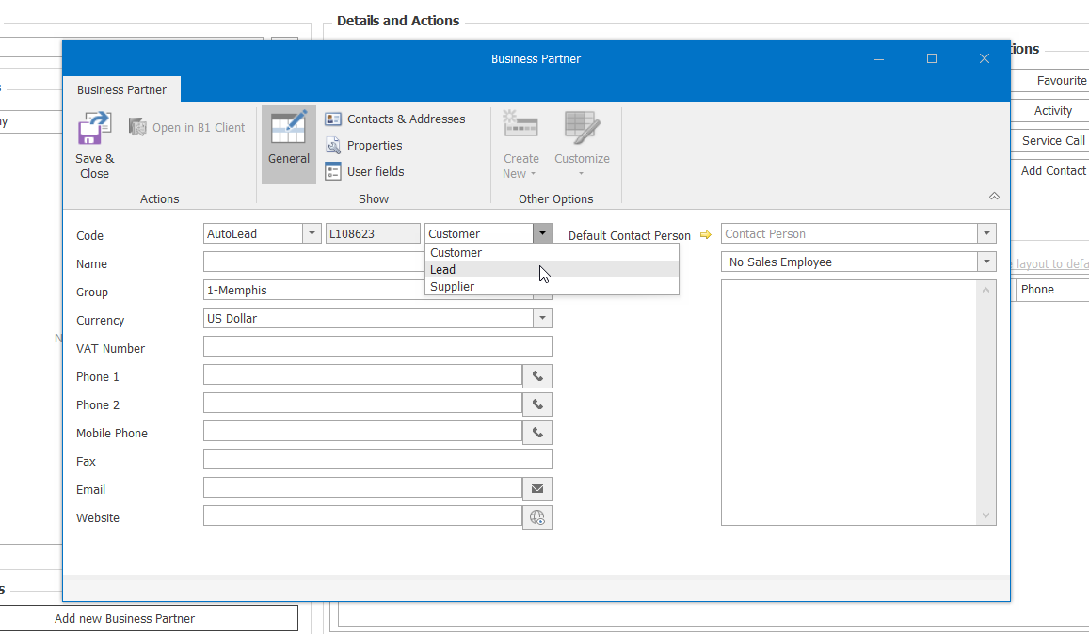
Adding a New Business Partner
Once you have confirmed through thorough research that your prospect does not exist as a Customer or Lead, proceed with the following steps:
In Outlook, click on the first SAP tab in the top ribbon.
Click the Find button.
Click the “Add a Business Partner” link.
Click the second dropdown box in the Code line and select Lead.

Slide 18
Adding a New Business Partner (cont.)
Enter the name of the Business/Entity from the business card or website. Enter the name exactly as it is on your reference.
In the Group field, select the appropriate MCC location from the dropdown.
Enter the phone number for the business/entity.
Enter the email address if you have it
Enter the business website if there is one.

Slide 19
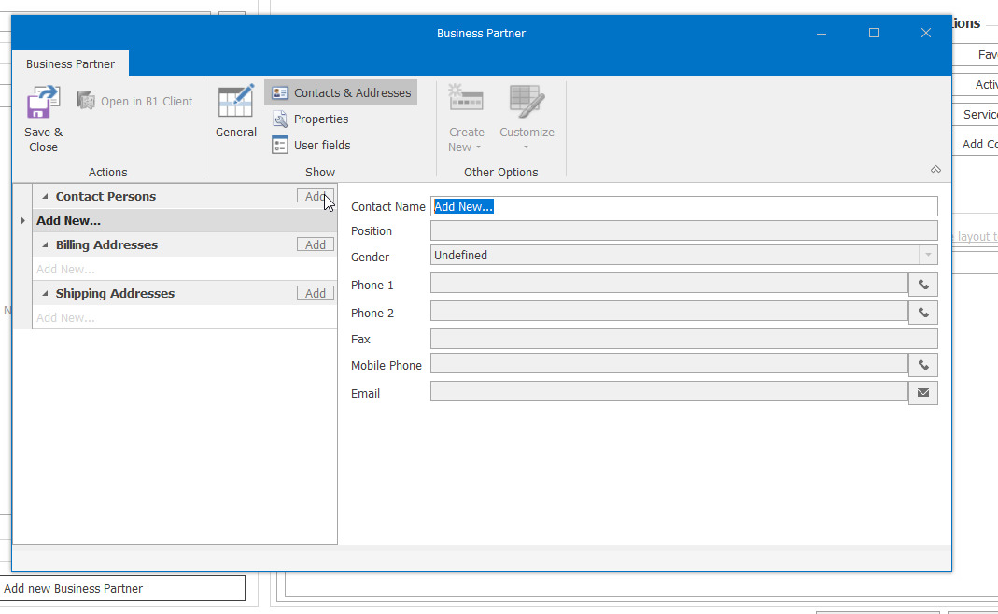
Adding a New Business Partner (cont.)
Click the Contacts & Addresses button at the top.
Click the Contact Persons “Add” button.
Enter the full name of your contact in the Contact Name field.
Enter the rest of the contact’s info in the rest of the fields.

Slide 20
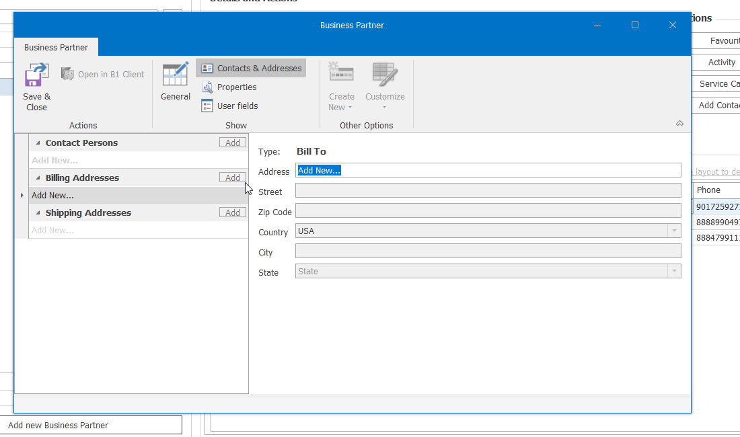
Adding a New Business Partner (cont.)
Click on the Add button for the Billing Address (this might be different than the contact address).
In the “Address” field, enter the name of the business.
Street – Enter the full street address including suite or building #.
Enter the City, State, and Zip Code.
If the Shipping address (location of the actual system) is different from the Billing address, click the Add button next to Shipping Address and enter all the information as you did for the Billing Address.
Click Save & Close at the top to submit the information and add the Business Partner to SAP.

Slide 21
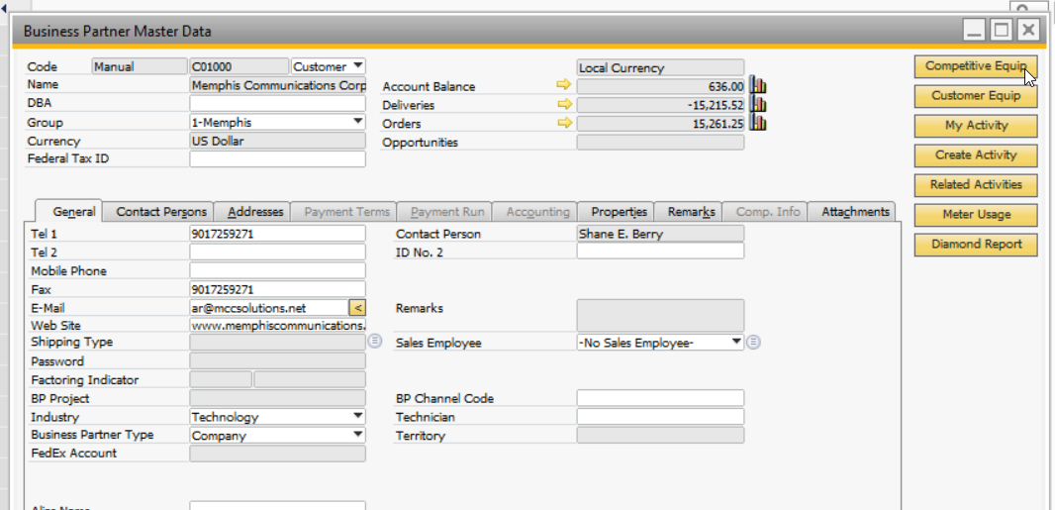
Adding Competitive Equipment
NOTE: Competitive Equipment can ONLY be entered through the SAP client. You cannot enter Competitive Equipment through Outlook.
Log into the SAP client with your SAP credentials.
After SAP and all add-ons have fully loaded, click on the Business Partner module from the left menu.
Click on Business Partner Master Data
In the Business Partner window, search for the business by name, contact, or phone number.
Click on the Competitive Equipment button in the top right corner.

Slide 22
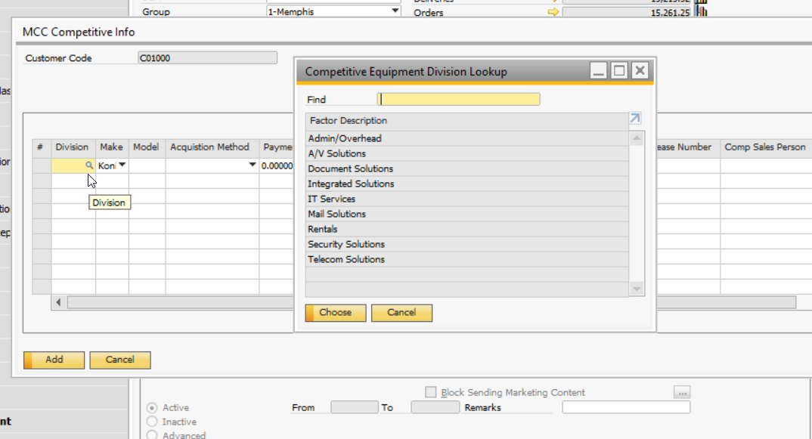
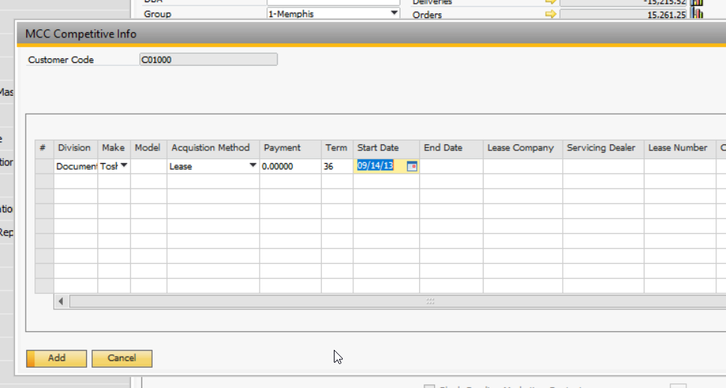
Adding Competitive Equipment (cont.)
Click in the Division field and select the Magnifying Glass.
Select the correct division from the dropdown list. DO NOT MANUALLY ENTER THE DIVISION.
Enter the Make, Model, etc., of the competitive equipment.
In the Acquisition Method field, select Lease from the dropdown list.
In the Term field, enter 36 month if you do not know the term.
Enter a Start Date for the lease. This ensures you have a reminder of the appropriate time to contact them when the lease expires.
Select the Competitive Dealer from the dropdown list.
If there is more than one piece of competitive equipment, enter the additional equipment in the next line.
Click the Add button at the bottom of the window.
To validate the info was added, click on the Competitive Equipment button again.

Slide 23
Adding Opportunities

Slide 24
Adding a Sales Opportunity
The purpose of the Sales Opportunity module is to track the entire sales process from beginning to end. Sales Representatives should create a Sales Opportunity for every prospect/opportunity in order to have one central location for all Activities, Documents, etc. related to the possible sale as well as keeping a record of prospects for future opportunities.
Tracking your activities and documents against a Sales Opportunity enables greater insights into your performance as a Sales Representative and provides you with information from which you can learn and alter your approach to future sales opportunities.

Slide 25
Sales Opportunity Steps
Create Opportunity at Beginning of Sales Process
Create Sales Quote and link to Opportunity
Create Activities linked to the Opportunity
Change the status of the Opportunity to Won or Lost

Slide 26
Adding a Sales Opportunity
There are 3 main ways to create a Sales Opportunity from the CRM for Outlook.
From an email from the client – Use this method when you already have an email from the client as it auto populates the client info.
From the BP info in the Find window – Use this method if you do not have an email or do need to search for the client first
From the SAP: MY Data tab – Use this method to create a blank Sales Opportunity and enter the client name manually
Once the Sales Opportunity window is open, the steps for creating an opportunity are the same.

Slide 27
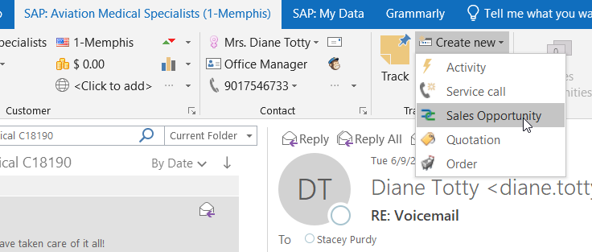
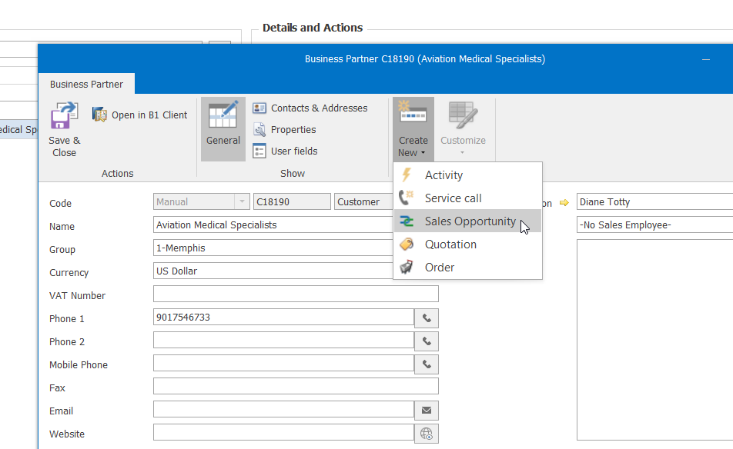
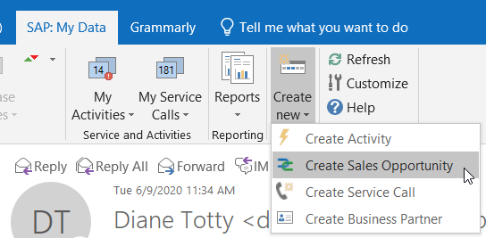
From an Email
From Find Window
From SAP:
My Data
Select an email from the client you want to create an opportunity for.
Click Create New
Click Sales Opportunity
Click the Find button and search for your client
Click the Golden Arrow next to the business name
Click Create New
Click Sales Opportunity
Click the SAP: My Data tab
Click Create New
Click Create Sales Opportunity

Slide 28
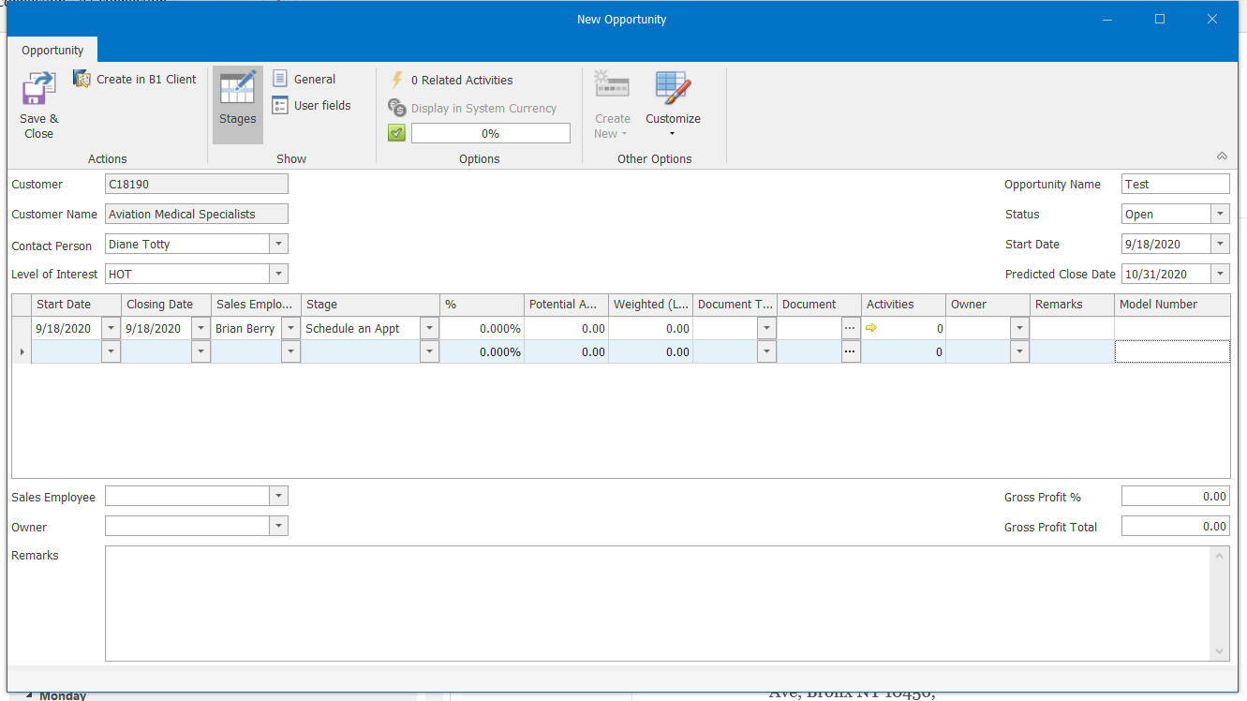
Adding a Sales Opportunity (cont.)
Open a new Sales opportunity using one of the three methods from the previous slides.
If you created a sales opportunity from an email or from the Golden Client on the BP, all the client info will be pre-populated.
If you created a sales opportunity from the SAP: My Data tab, you will need to enter either the BP Code or Customer Name
Choose the contact person from the list which should include the Contact that you entered during your prospecting.
Indicate the Customer’s “Level of Interest” in the new product.
Enter an Opportunity Name in the top right
Best Practice: Use the model name of the potential sale equipment as the Opportunity Name
Add the Start Date in the top right
NOTE: The Start Date may be prior to the date you opened the Opportunity depending on the initial contact of the prospect
Enter a Predicted Close Date in the top right

Slide 29
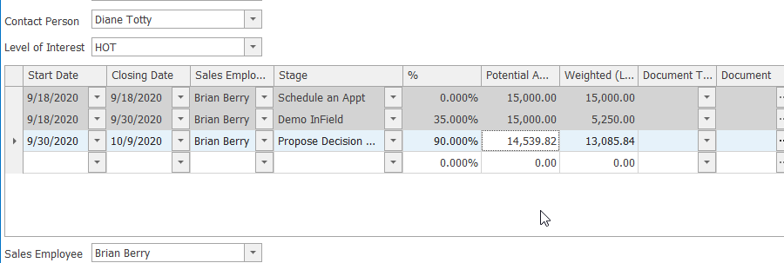
Adding a Sales Opportunity (cont.)
Adding Stages to a Sales Opportunity
The table in the center of the Sales Opportunity is the Stages Table. Each stage of the sales process should be added as a new line to the Stages Table. This allows you track the entire sales process from beginning to end and provides insight into potential issues. Stages are as follows:
Schedule an Appt
Approach
Lead
In-Field Demo
In-House Demo
Propose Influencer
Propose Decision Maker
Close
Deliver, Train, Collect
Future Upgrade
Add the Start and End Date for this particular stage
Select the Sales Employee for this stage
NOTE: This may be someone other than the person currently working the Opportunity. For example: An opportunity has been transferred to a new salesperson when someone leaves the company. The ex-employee would be the salesperson for the stages they worked and the new salesperson would be on the new stages.
Select the appropriate Stage
The % field will automatically change as the Stage changes. This will tell you how far you have progressed through the sales process
Enter the Potential Amount of the sale
NOTE: In the early stages this will be an estimate. As the sales process continues, and actual amounts are known, the Potential Amount should be reflected in the lines for those stages but should not be changed in the earlier stages.

Slide 30
Adding a Sales Opportunity (cont.)
Adding Documents and Activities will be covered in detailed in later slides. For now, move to the bottom of the Opportunity window to finish adding the Opportunity.
Select the Sales Employee – Click the drop down and start typing to the first name to find the Sales Employee
Select the Owner: lick the dropdown and begin typing the LAST name of the Owner
NOTE: The Sales Employee and Owner may be different people depending on the situation. If a manager opens an Opportunity for a Sales Rep, the manager would be the owner and the Rep would be the Employee. If marketing opens a web lead Opportunity, marketing would be the owner and the rep would be the Sales Employee.
Enter the Gross Profit Percentage
Click the General button at the top of the Opportunity window
Select the correct Information Source from the dropdown
Select the Industry
Click Save and Close

Slide 31
Adding Activities

Slide 32
Adding a Sales Activity (cont.)
The purpose of the Sales Activity is to track the stages of the Opportunity and track the activities that are executed for the Sales Opportunity.
Linking Activities to your Sales Opportunity enables great insights into your performance as a Sales Representative and provides information from which to learn and alter your approach to future sales opportunities.
Activities created from within the Sales Opportunity window will be linked to the Sales Opportunity. All Follow Up activities created from that Activity will also be linked to the Sales Opportunity.
Activities created outside of the Sales Opportunity window will be related to the BP but not to a specific Sales Opportunity.

Slide 33
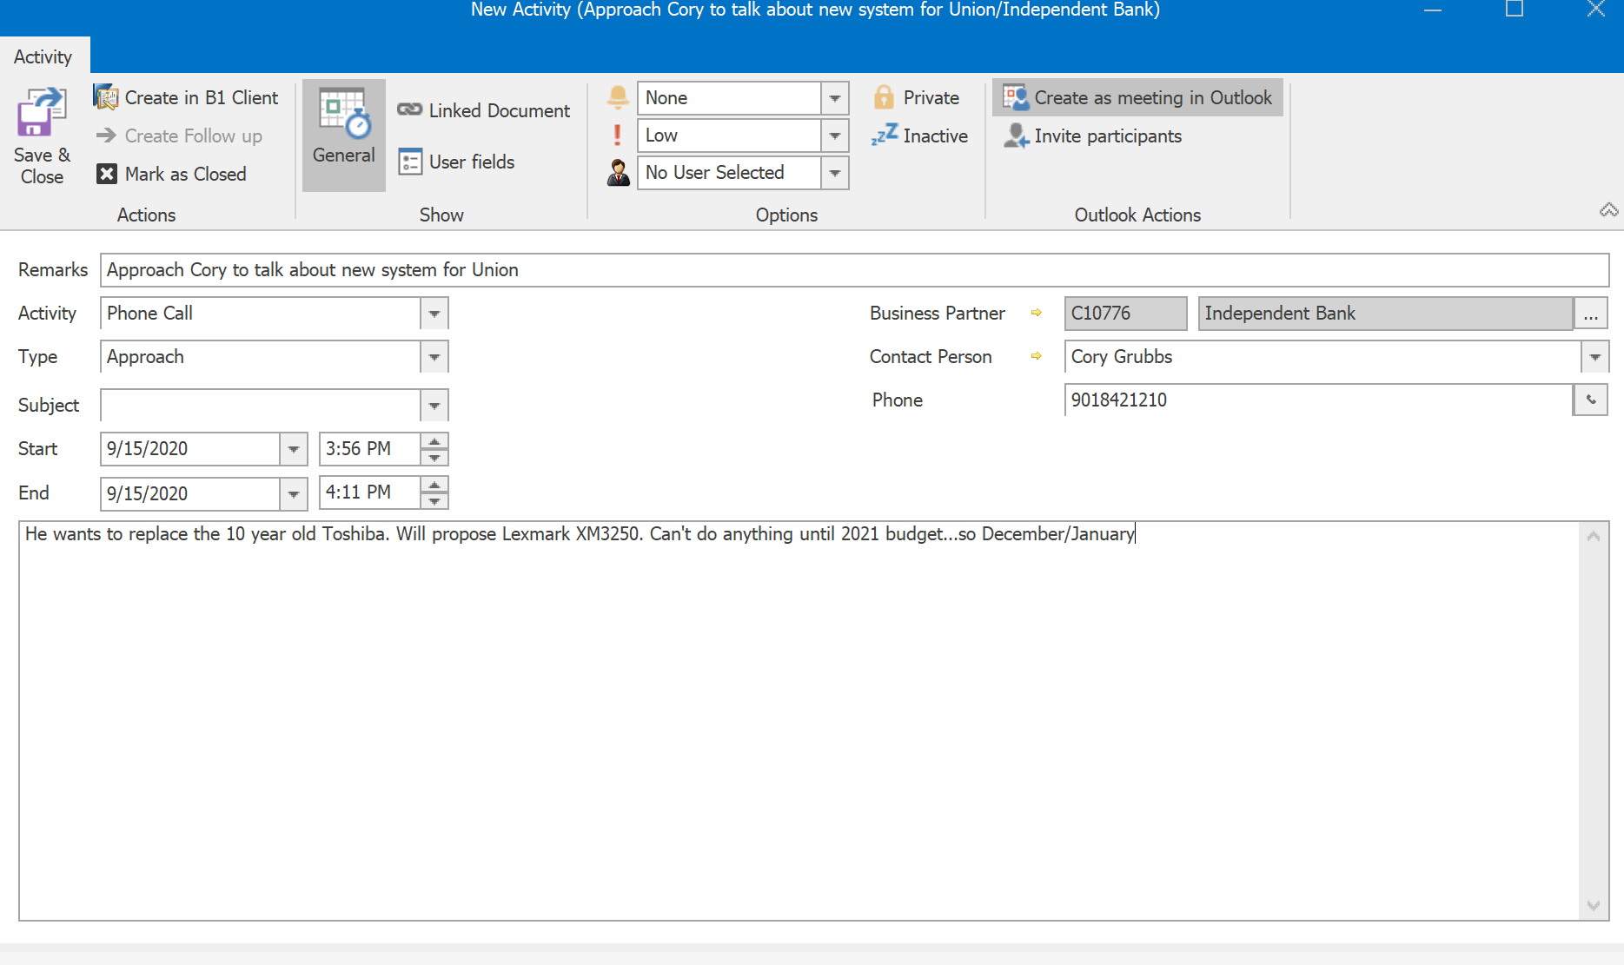
Adding a Sales Activity (cont.)
After you have set up the Sales Opportunity, the next step is to create an Activity linked to the Opportunity.
From either tab of the CRM, locate and open the Sales Opportunity
Click the golden arrow in the Activity field of the current Stage. Each stage of the Opportunity should have at least one Activity linked to it. Activities should begin with the Approach and progress through each step of the sales process.
Click on the ‘Create as meeting in Outlook” button to add this activity to your Outlook calendar.
If you need to include the customer in this Activity, click the Invite Attendees button and enter the addresses of the people you want to send the invitation to.
Enter the necessary info in the Remarks line. This should be a basic subject of the activity.
Select the Activity from the dropdown menu. This should be Phone Call, Meeting, Note, etc.
Ensure that you put in the “Type” as this is important to make sure that this Activity is reflected on the Quota dashboard. At the initial point, this should be an Approach.

Slide 34
Adding a Sales Activity (cont.)
After you have set up the Sales Opportunity, the next step is to create an Activity linked to the Opportunity.
Make sure the correct contact person is listed
Set the correct dates and times for your activity
Enter in additional information or next steps in the large text box.
Click Save and Close.
If you have clicked the Invite Participants button, Outlook will now open a meeting invitation with all the info from the Activity pre-filled. Add the contact’s email address to the TO line.
Proofread all information in the Outlook Invitation to confirm you are only sharing information you wish the customer to see. Changing information in the invitation will not change information in the Activity.
Once you have saved the Activity, you can click the Refresh button in the CRM and the activity will appear in your list. You can use the To-Do List in the CRM as your daily task manager and see all the Activities ready to be handled.

Slide 35
Adding a Sales Activity (cont.)
Follow up Activities
Once an Activity has been completed, you will need to mark that Activity as Closed.
Open the Activity
Click the Mark as Closed button
If a follow up activity is required, click the Create Follow up button.
A new Activity window will open with all the information from the original Activity.
Follow the same procedures for creating the original Activity.
Make sure to mark the original Activity as closed and click Save and Close.
Keeping your Activities list clean by ensuring you close out Activities as they happen will keep you organized and make sure we have good data in SAP.

Slide 36
Creating Sales Quotations

Slide 37
Adding Sales Quotations
The Sales Quotation document can only be added through the SAP client. You cannot add a new Sales Quote from the CRM for Outlook.
The Sales Quotation will be used to create the configure the equipment, enter the MA information, prepare the lease information, and generate the proposal documents.
All proposals from this point on should be created through the Sales Quotation form and then be linked to your Opportunity.

Slide 38
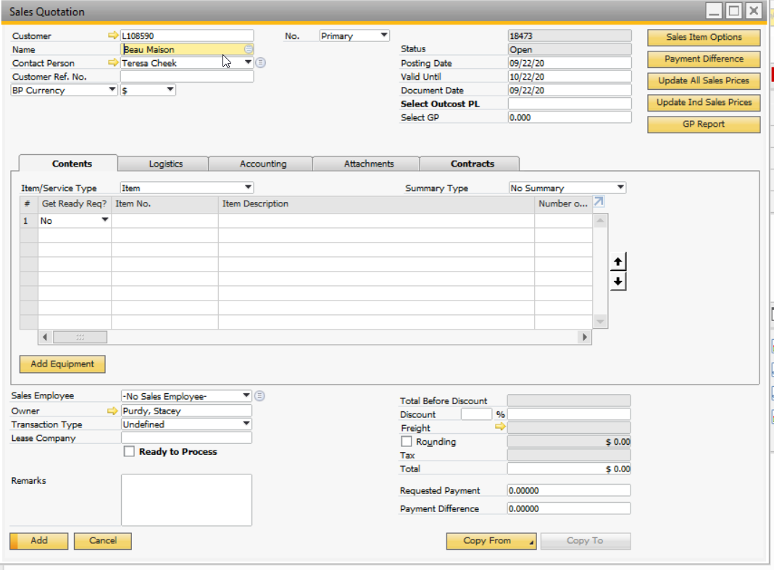
Adding a Sales Quotation
Open the SAP client, log in, and wait for all addons to finish loading. Once your see Forza is Ready on the bottom of the screen, it is ready to use.
Open a new Sales Quotation by clicking on the Sales A/R module and clicking Sales Quotation or from the Sales Quotation link in your Common Functions shortcut
Click in the Name field and begin typing the name of the Business
A dropdown will appear as you type with a list of matching clients
Select the correct one and all BP info will populate in the correct fields
Make sure the correct contact person is selected

Slide 39
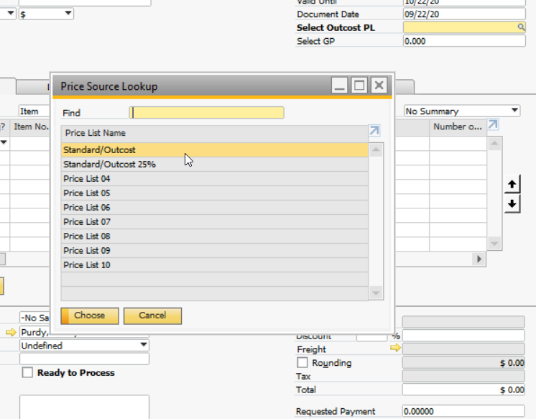
Adding a Sales Quotation
In the Select Outcost PL field, click the magnifying glass.
Select the correct Standard/Outcost Pricelist from the menu.
You should have a couple Pricelist options available
The Outcost Pricelists calculate the correct selling cost of the equipment for you
The Standard/Outcost PL calculates the price at our standard 40%.
The other Standard/Outcost Pricelists calculate the price at lower percentages that might be used.
If you have selected the correct pricelist, you should not need to adjust the cost manually of any item.

Slide 40
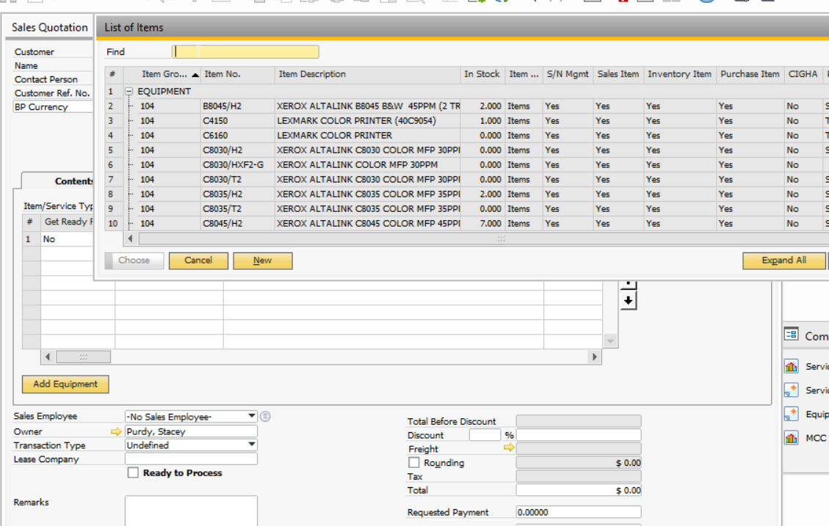
Adding a Sales Quotation
Equipment Builder: the Equipment Builder addon allows you to easily and quickly configure any system with all line items added to the Sales Quote.
Click the Add Equipment button
In the new window, select the base model by either
Clicking the + next to Equipment and highlighting the correct base model
Or typing the item number and then selecting the correct base model
Click Choose

Slide 41
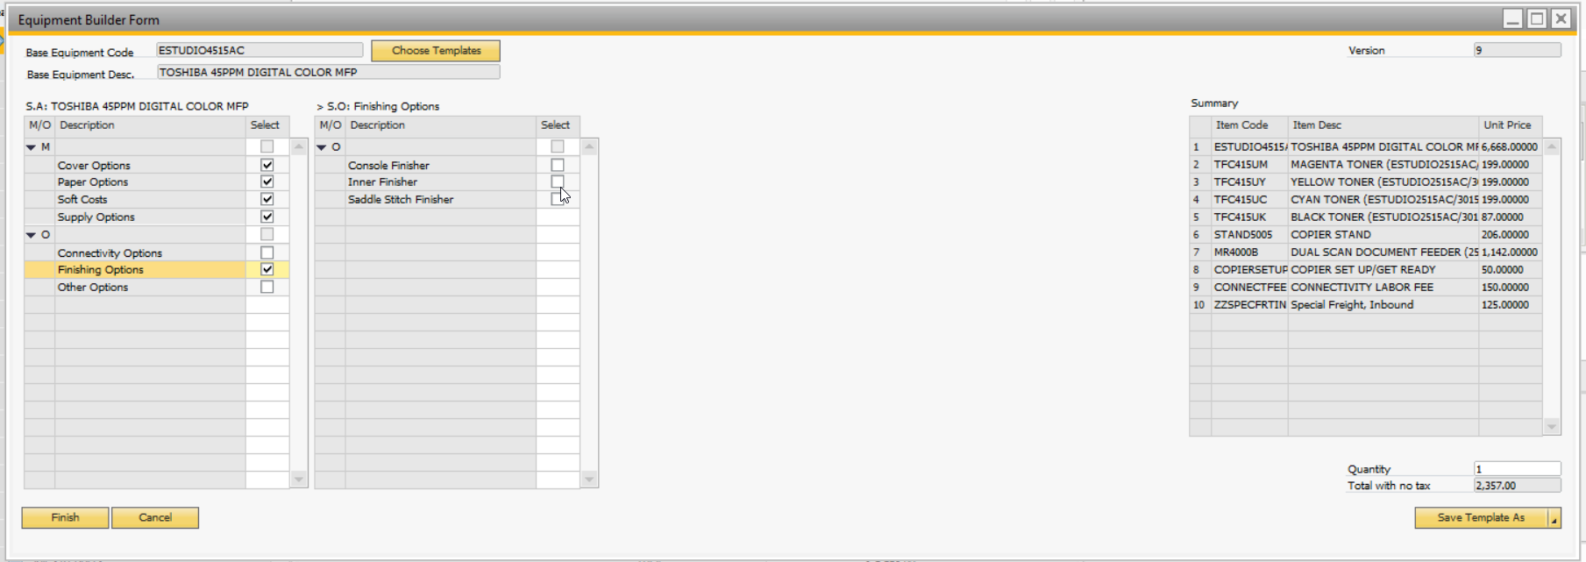
Adding a Sales Quotation
From the Equipment Builder window, you can manually configure the equipment as you need or you can choose a pre-built template and modify as needed.
To configure a system using a pre-built template, click the Choose Template button at the top left of the window
The selected items will load in the table to the right
To add or remove items, check the boxes to the left for the appropriate item
Once the item is configured correctly, click Finish
NOTE: The items are separated into Mandatory and Optional items. Items list at the top are Mandatory. The Equipment Builder will not let you complete a configuration unless all mandatory selections have been made.

Slide 42
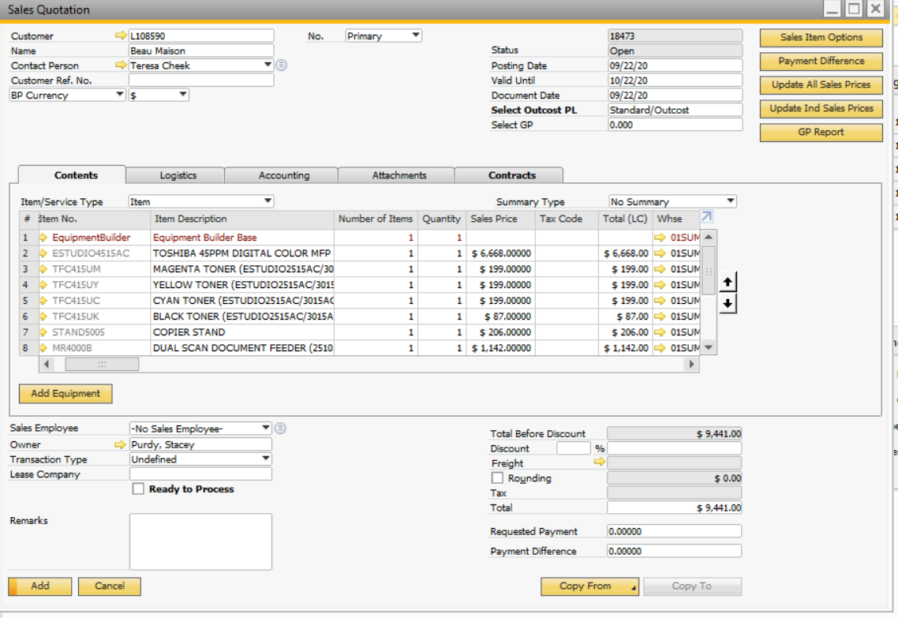
Adding a Sales Quotation
Once you click the Finish button, BE PATIENT. It takes time to load all the line items from the configuration to the Sales Quotation.
Once the line items have finished loading, you will see the full configuration and will be able to see the cost and availability of each item.
If you need to make adjustments to the configuration, right click on one of the lines and select Rebuild Equipment.
To build a second system, click the Add Equipment button again.
Select the Sales Employee from the dropdown
Select the magnifying glass in the Leasing Company field and select the correct leasing company.

Slide 43
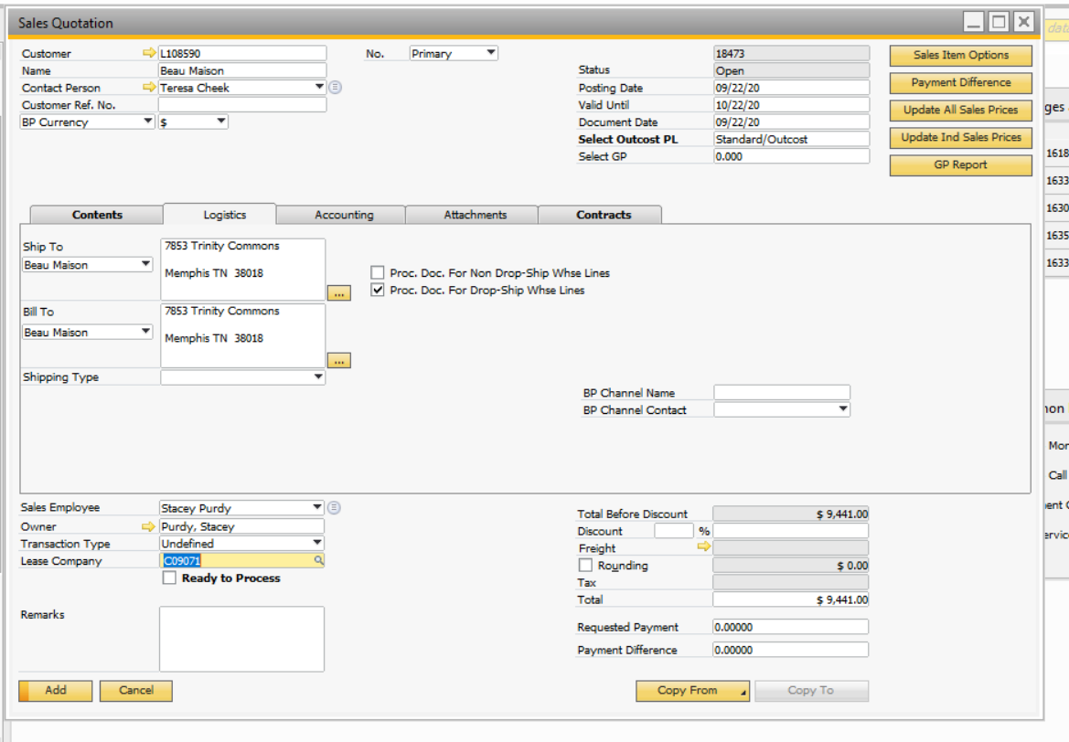
Adding a Sales Quotation
Click the Logistics tab and make sure the correct address information is listed.

Slide 44
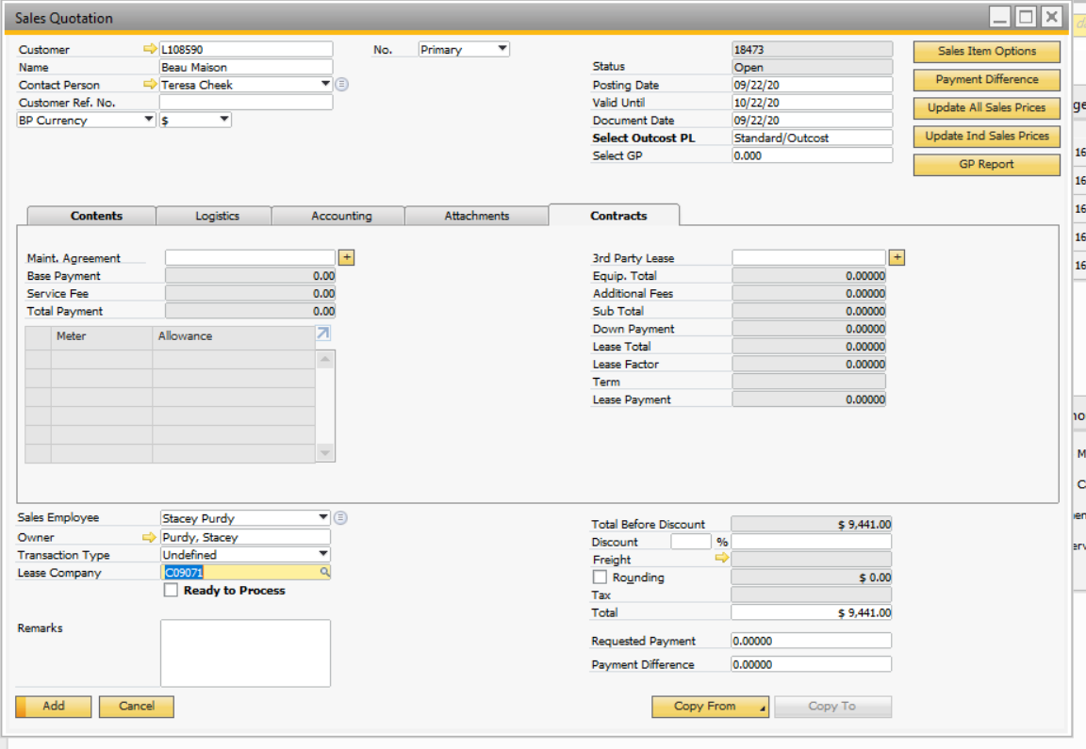
Adding a Sales Quotation
Click the Contracts tab. On this tab you will be able to configure the Maintenance Agreement and Lease information.

Slide 45
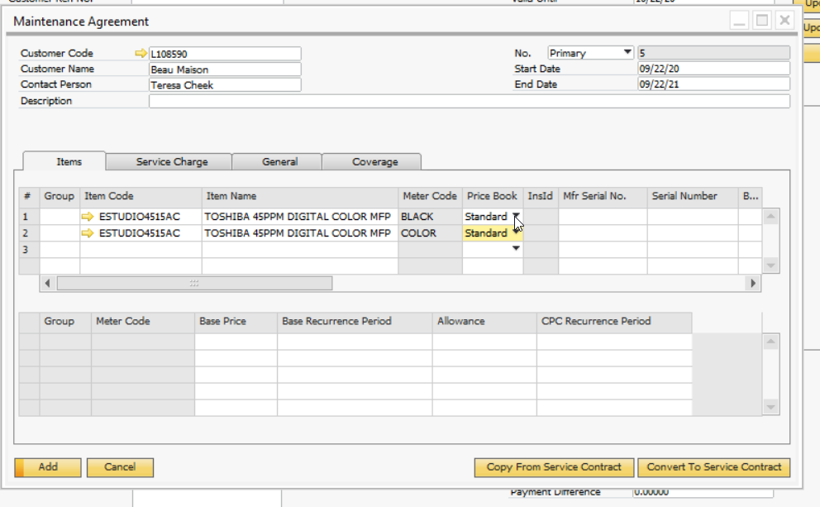
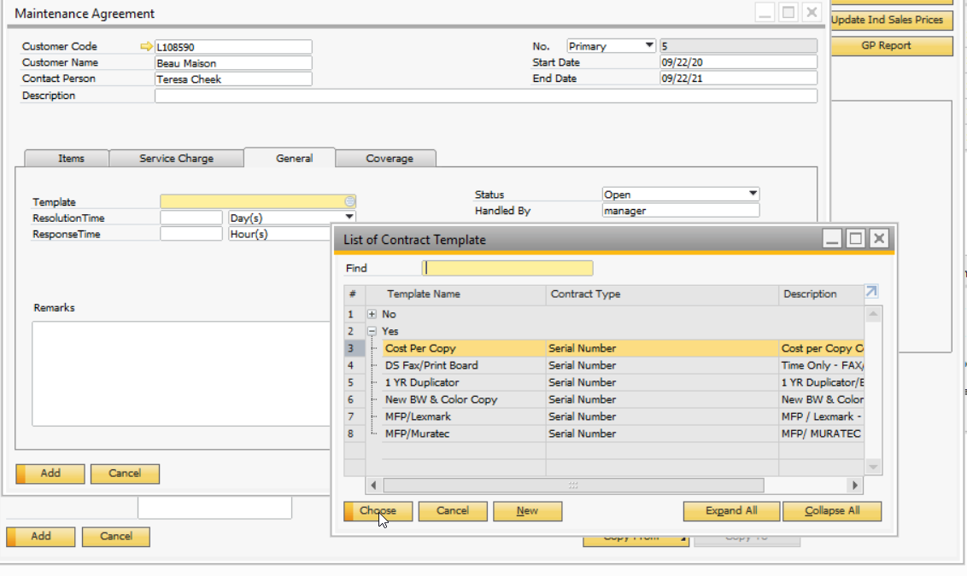
Adding a Sales Quotation
On the Contracts Tab, click the + next to the Maintenance Agreement field to begin adding the MA information.
Select the Standard Price Book from the dropdown list for all Meter items
Costs and allowance will populate automatically. If you need to make adjustments, manually adjust for each item needed.
Click on the General Tab
Click the Circle menu in the Template field
Select the correct contract template for your system
Click Choose
This will auto-populate the Response time fields as well as the consumables on the next tab.

Slide 46
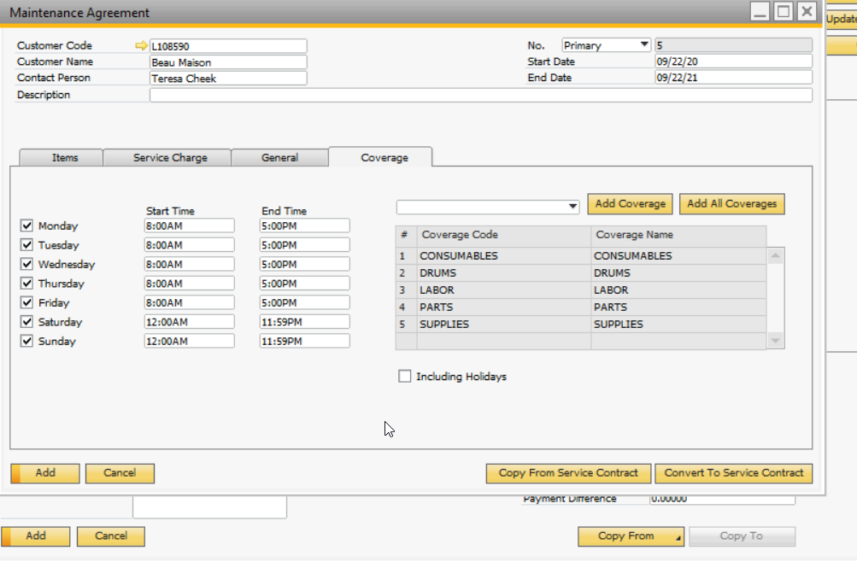
Adding a Sales Quotation
On the Contracts Tab, click the + next to the Maintenance Agreement field to begin adding the MA information.
Click the Coverage tab
The Consumables from your contract template should appear here. If you need to make additions, click the Add Coverage button.
Make any adjustments if needed
Click the Add button to complete the MA configuration

Slide 47
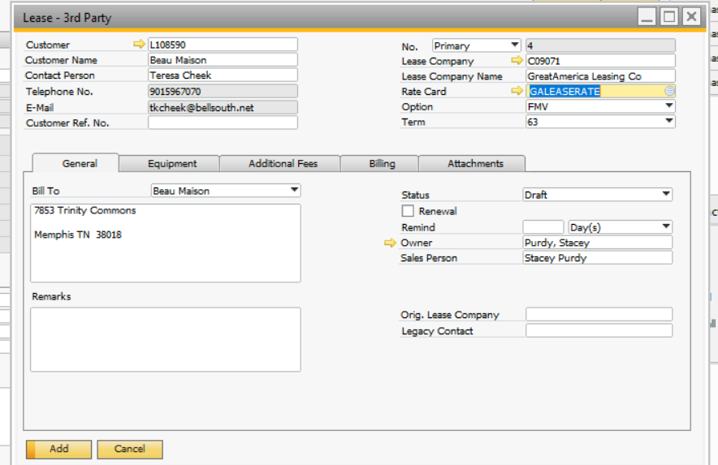
Adding a Sales Quotation
On the Contracts Tab, click the + next to the 3rd Party Lease field to begin adding the Lease information.
Enter the BP Code of the Leasing Company from the main SQ window (enter earlier in the process)
You can also manually enter or search for the leasing company, but using the number from the SQ will ensure you enter the correct BP info)
Select the Lease Rate Card (there should only be one per leasing company)
Select the leasing Option: FMV or $1 Out
Select the lease Term from the dropdown
Ensure the correct Bill To address is listed

Slide 48
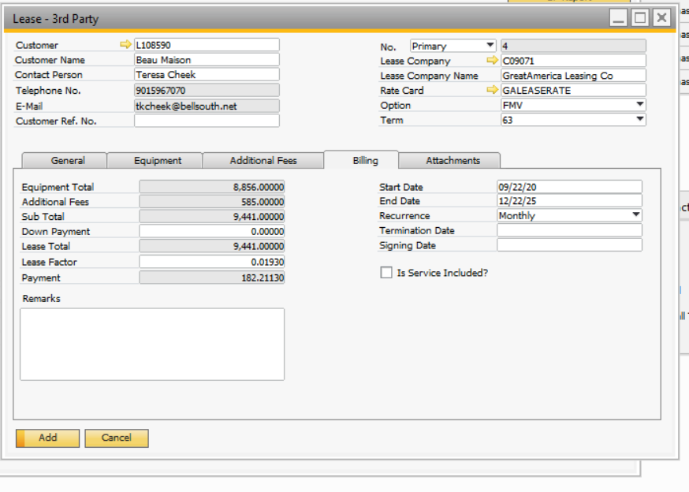
Adding a Sales Quotation
On the Contracts Tab, click the + next to the 3rd Party Lease field to begin adding the Lease information.
Click the Billing tab
This tab will show you the payment and other leasing information.
Adjust the Recurrence frequency if needed
If the MA is being billed with the lease, check the Is Service Included box.
Click the Add button

Slide 49
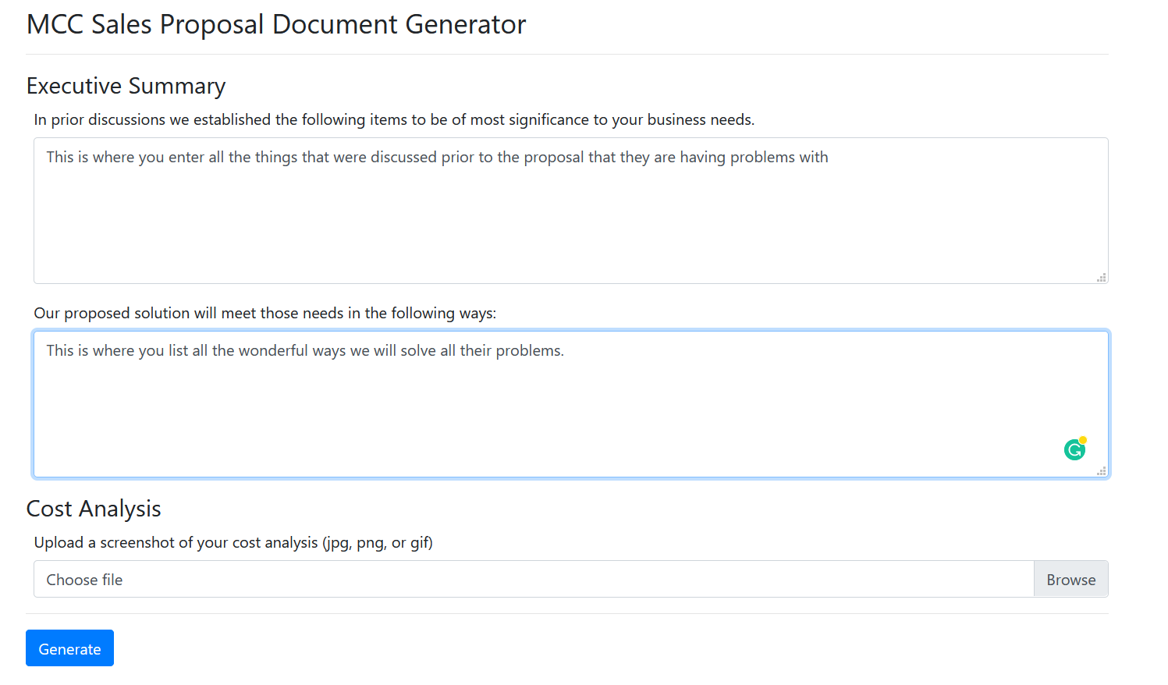
Adding a Sales Quotation
The Proposal Generator will open in an internet browser outside of SAP.
Enter the Executive Summary information
Box 1 is to list the problems that were discussed prior to the proposal
Box 2 is to list all the ways our systems will solve those problems
If you have created a cost analysis outside of SAP, you can upload it by clicking the Browse button.
Uploads must be in .jpg, .png, or .gif image format. Take a screenshot of the cost analysis to quickly save it as an image.
Click the Generate button

Slide 50
Adding a Sales Quotation
The Proposal will be generated as a .pdf document that can then be emailed to the client or printed and hand delivered.
All Sales Quote information will be added to the proposal documents so no modification needs to be done.
At this time, lease documents have not been added to SAP and still need to be generated outside of SAP, but all calculations are available on your Sales Quote.

